Slide 1
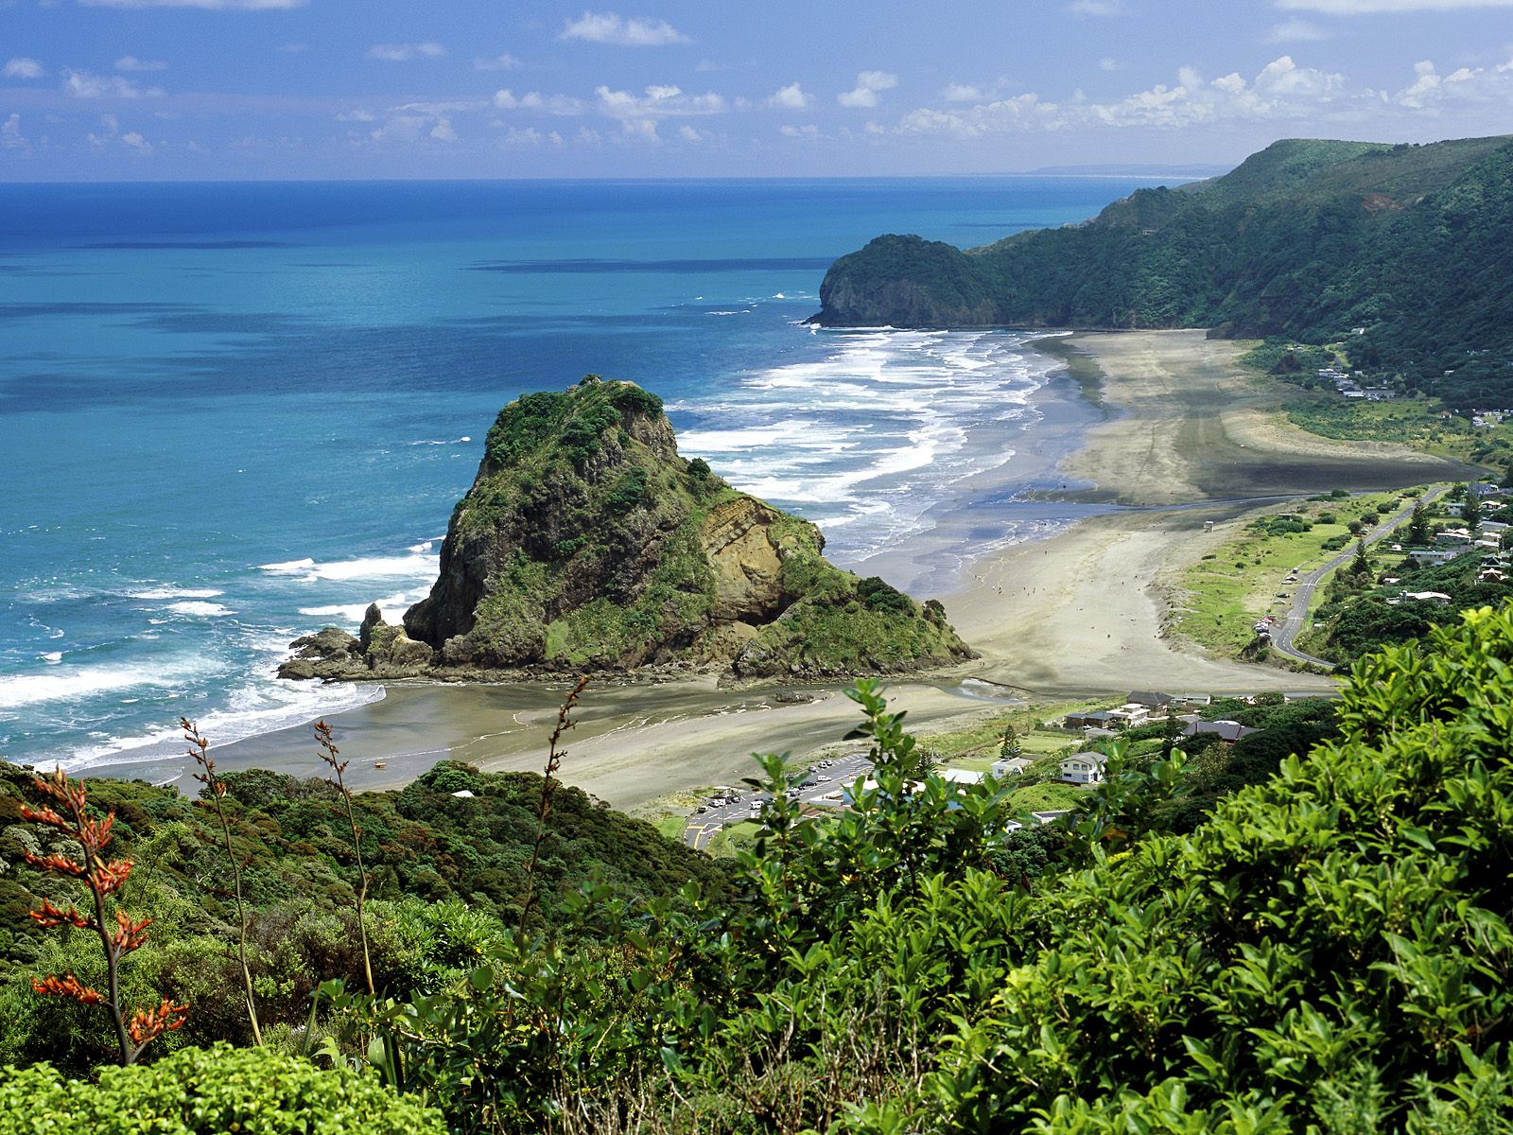
Walkland
A project by Warwick 240

Slide 2

The Problem

Slide 3
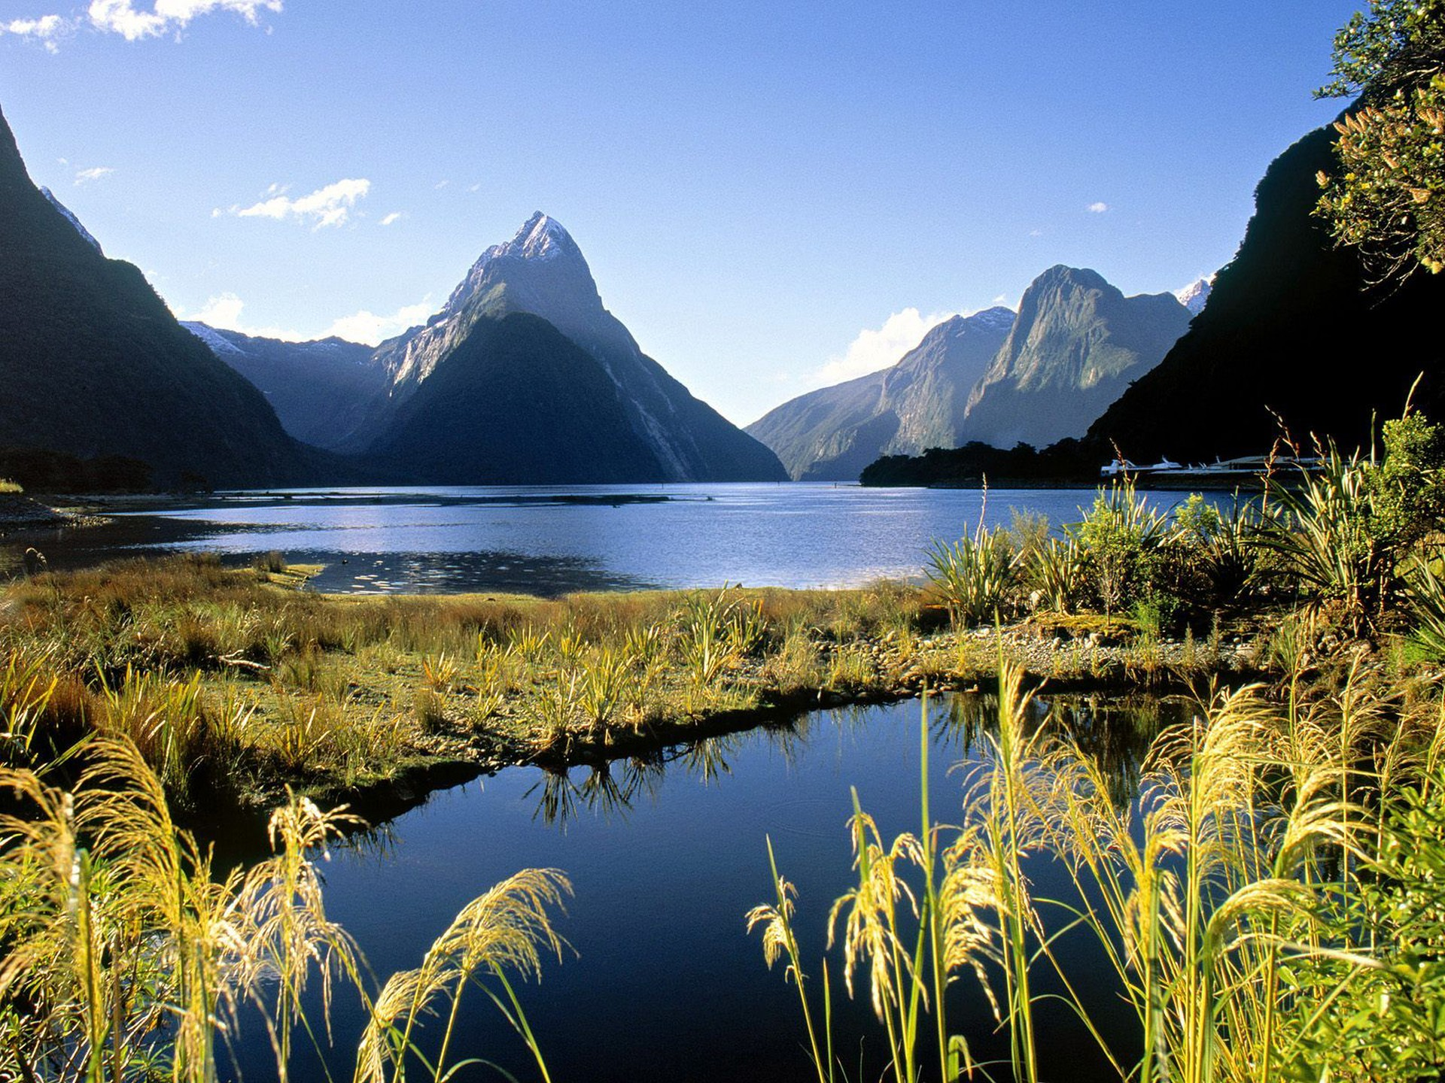



Our Approach

Slide 4

Live Demo

Slide 5
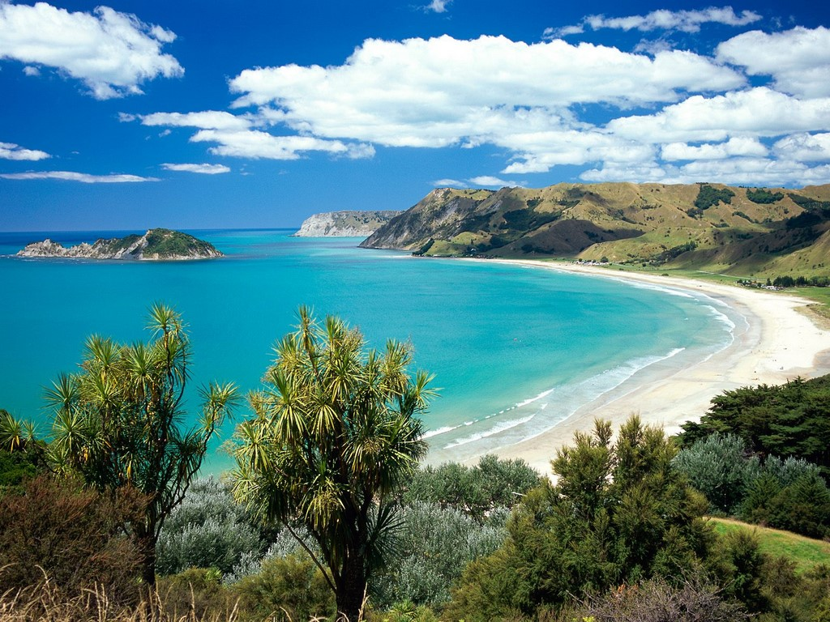
Design

Slide 6
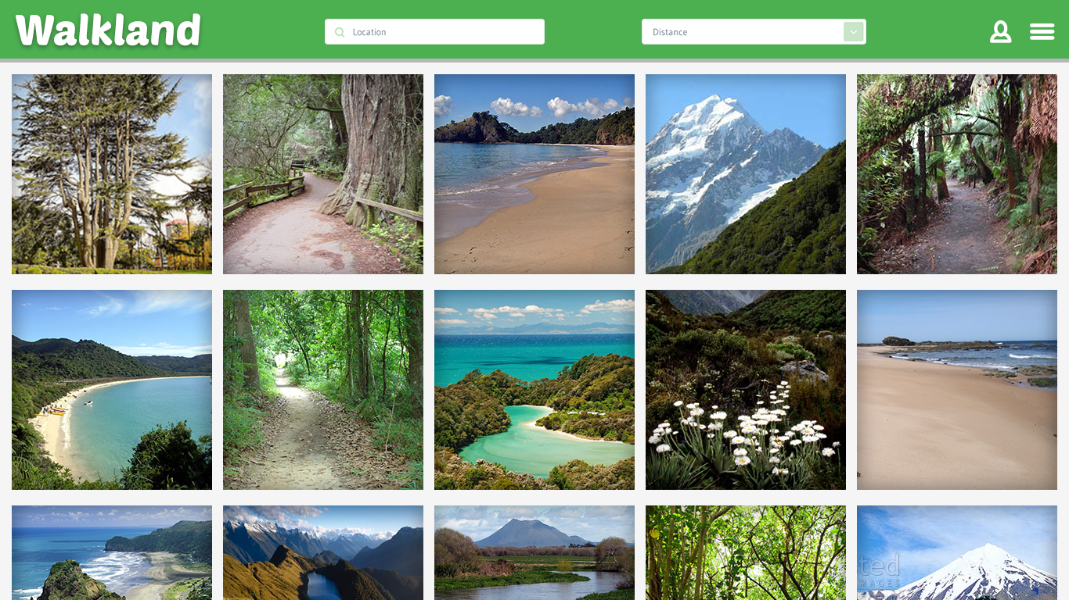

Slide 7
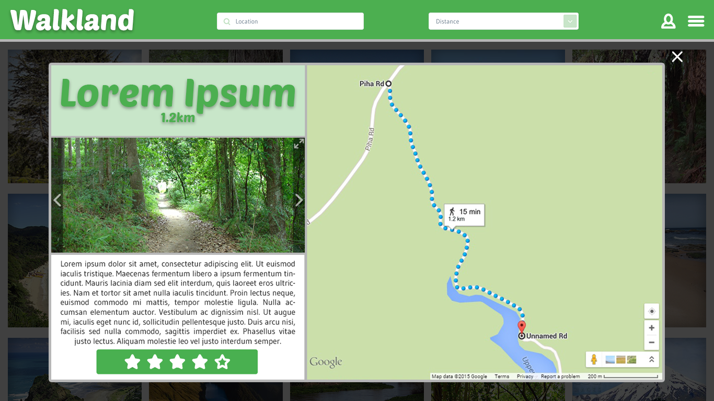

Slide 8
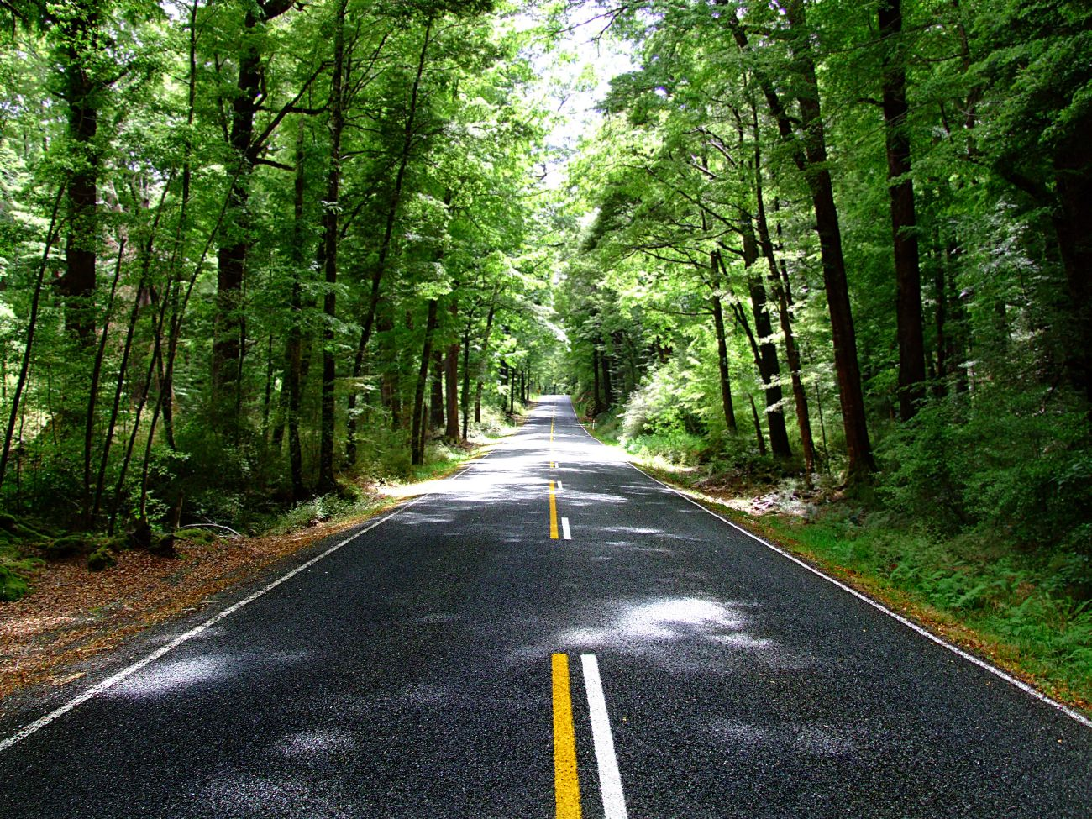
Future Development
User Accounts
Social, Ratings, User Images
Expand from Auckland to the rest of New Zealand!

Slide 9
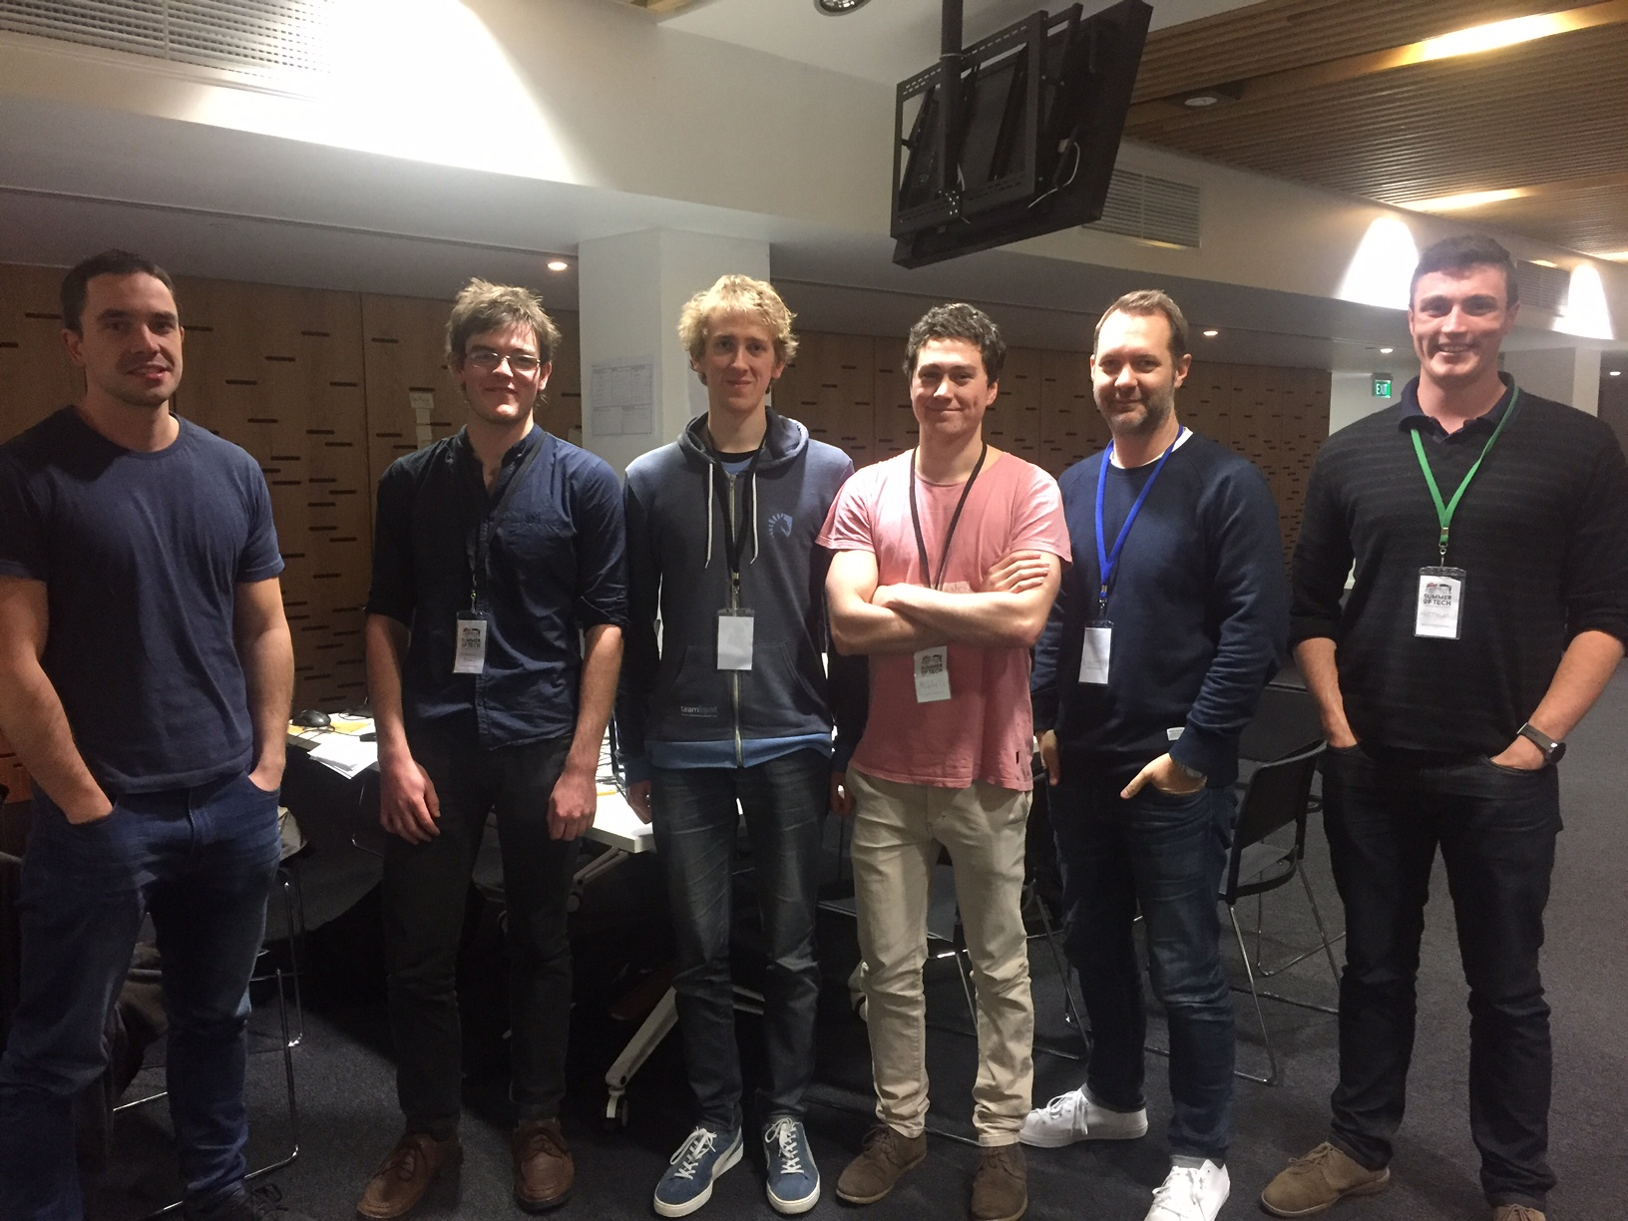
Cheers!
Any questions?

